Slide 1
Is this you?

Slide 2
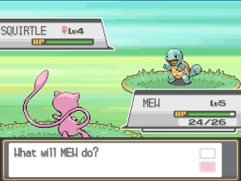
Do you like this?

Slide 3
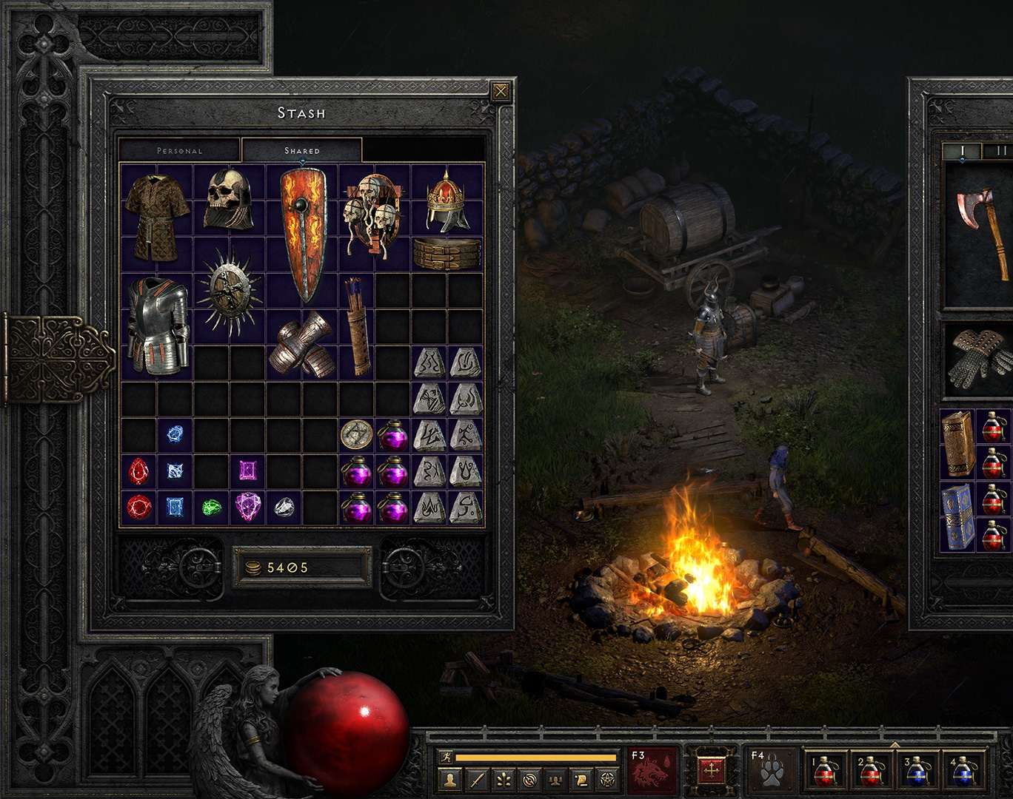
Do you miss this?

Slide 4

Depression?

Slide 5

You?

Slide 6
Welcome to..

Slide 7
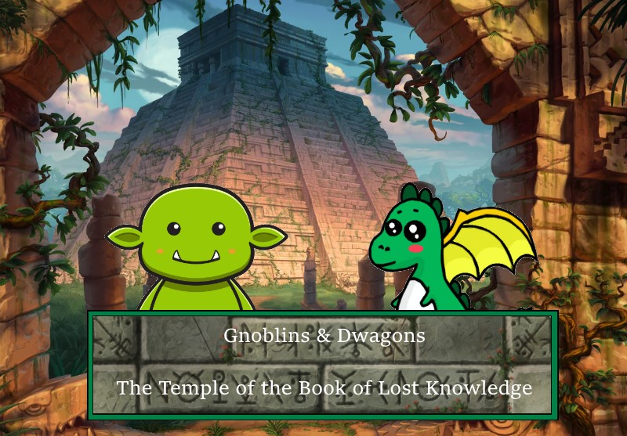

Slide 8



Slide 9
So why would i give fuck?

Slide 10

Turn based combat like Pokemon

Slide 11

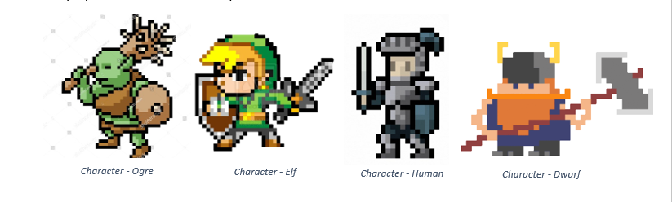
Different builds

Slide 12


Puzzles for nerds like you

Slide 13
And last but not least..

Slide 14

A great story line

Slide 15

It comes with
Adventure
Betrayal
Plot twist
Murder
Prejudice
Christopher Nolan-esque execution

Slide 16

What more can you ask for??

Slide 17
Oh yeah..

Slide 18
It’s a full game!!

Slide 19
No bullshit like..
Loot boxes
MTX
Membership
Slavery
DLC

Slide 20

IT EVENS RUNS ON YOUR TOASTER

Slide 21
So stop your pursue for hapiness
And buy..

